Slide 1

AnImal Shelter AnalysIs
PYTHON THINKERS
2022W AML 2103 Visualization for AI and ML
FINAL PROJECT

Slide 2
Team Members
Anto Francis (C0825095)
Omer Volkan Guney (C0831373)
Rupesh Chandran (C0826779)
Sachin Sreekumar (C0825096)

Slide 3

Introduction
Austin Animal Centre is the largest no-kill animal shelter funded by the government of Texas to protect the stray, lost, abandoned, and unwanted animals
The facility protects over 18,000 animals, mainly cats and dogs.
Data is a powerful tool and can be used to tackle any problems in any domain. This is the true vision of our project, and the love for animals is the main motivation to this project.

Slide 4
About Dataset
Data Source : https://www.kaggle.com/datasets/
Records from October 1st, 2013 to March 3rd, 2021
Dataset represents only the intakes. Intakes represent the status of animals as they arrive at the Animal Center.

Slide 5
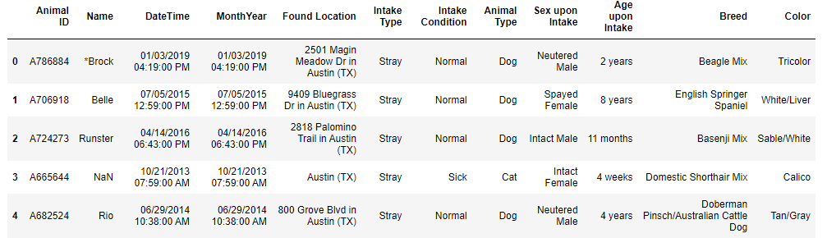
About Dataset(cont’d)
Dataset has over 100,000 records of data which covers details such as Animal name, Date, and location where the animal was found, type of intake, whether it is stray, wildlife, etc., condition of the animal during intake, and general features of animal such as type, sex, age, and breed.

Slide 6
Data WranglIng
Dropping Redundant Data
Check for missing values
Converting data types to categories
Replacement/Adjustment of Null Values
Converting the Age Column

Slide 7
Exploratory Data Analysis
What insights can be obtained from dataset of Austin Animal Center regarding animal intakes?
Animal Age Analysis
The Presence of Animal Names
Repeated Intakes

Slide 8
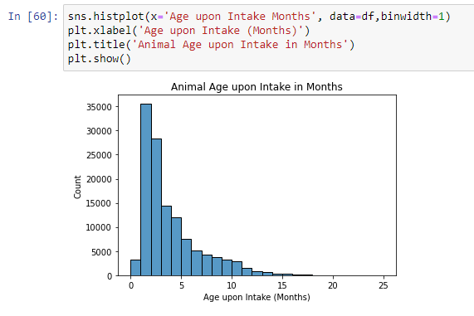
1.AnImal Age AnalysIs

Slide 9
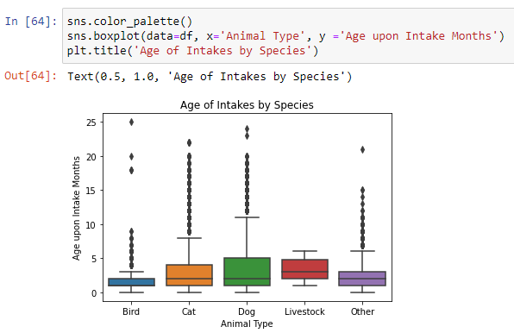
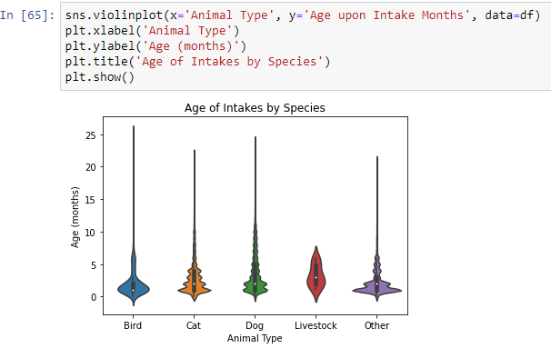
AnImal Age AnalysIs (Cont’d)

Slide 10
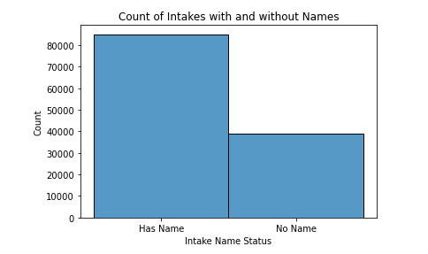
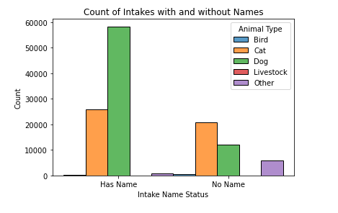
2-The Presence of Animal Names

Slide 11
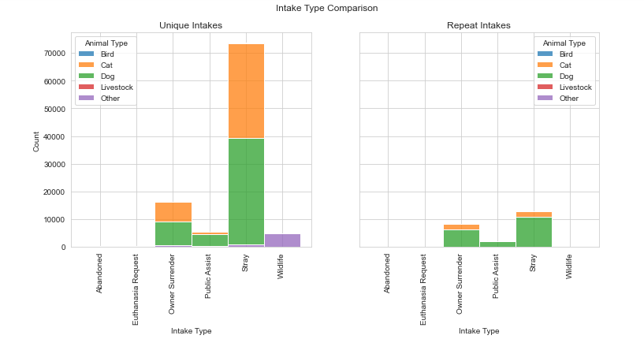
3-Repeated Intakes

Slide 12
ConclusIon
The age of intakes is skewed towards the younger side, with very few animals being taken in at over a year old
Types other than dogs and cats (Others category) are highly likely to have no name. This is likely explained by the fact that wildlife is included in the "Other" animal type.
Dogs account for the large majority of animals that were taken in multiple times , but Wildlife, somewhat obviously, is almost never taken in multiple times

Slide 13
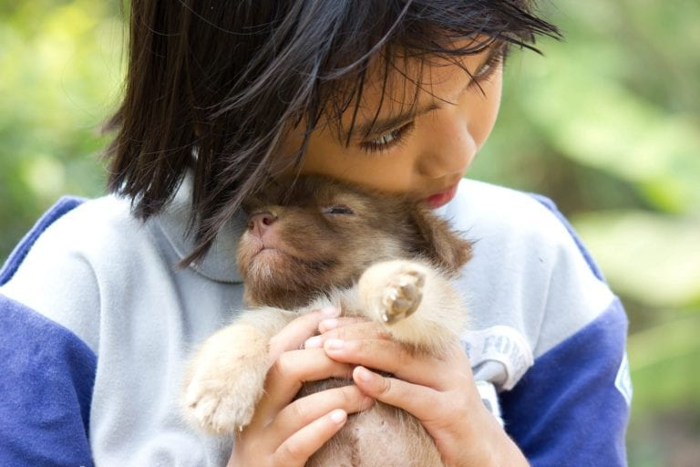
“Until one has loved an animal, a part of one’s soul remains unawakened.”
–Anatole France

Slide 14
THANK YOU!

